Slide 1
DPO-SYNT Usage Guide
A Short Example
Nicholas Recker

Slide 2
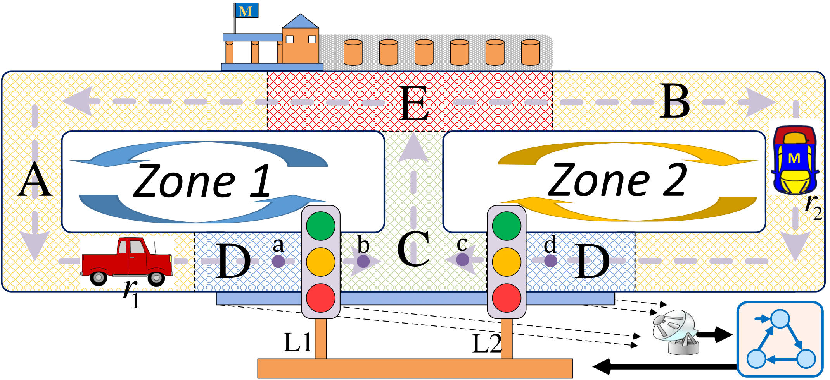
Example: Street Cleaning Robots
System Model
One way streets
Only one robot, r₁ or r₂, each day
Control
Two traffic lights, L₁ and L₂
When L₁ is red
r₁ at a must wait
r₂ at c may wait or turn right
L₂ is analogous

Slide 3
Sensing
Radar detects whether robot in D
Cannot distinguish between zones
Specification
Obey one way streets
Always eventually reach E
Events
a_{i}: r_{i} is chosen for the day
b_{i}: r_{i} empties trash at E
c_{i}: Robot crosses L_{i} either direction
O: Robot detected in D

Slide 4
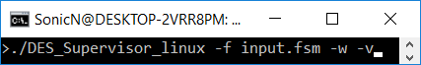
Command Line input
-f Provide an FSM input file
-w Write output to .fsm files in ./results
-v Write output to terminal

Slide 5
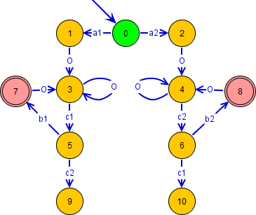
Input File: .fsm
.fsm file of original system
Desuma format
E.g.
11
0 0 2
a1 1 uc uo
a2 2 uc uo
...

Slide 6
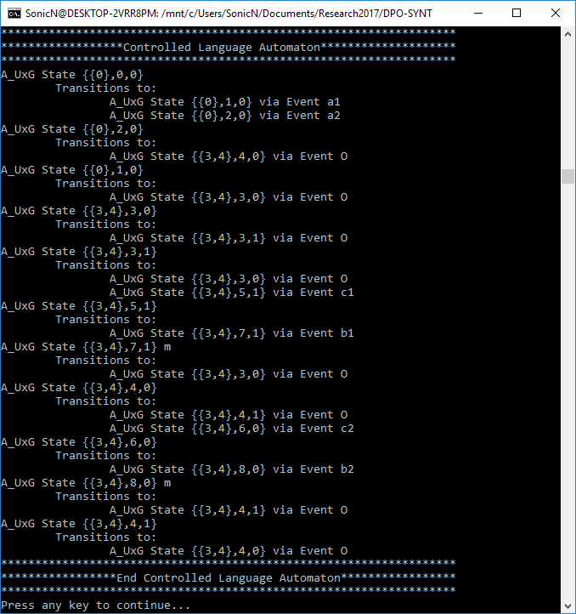
Command Line Output
Non-Blocking All Inclusive Controller
Unfolded Bipartite Transition System
Inter-Connected System
Live Decision String
Controlled Language Automaton (Shown)

Slide 7
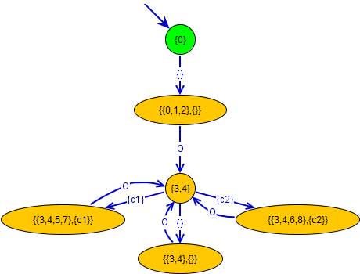
Output File: NBAIC.fsm
.fsm file of Non-Blocking All Inclusive Controller
Desuma Format
E.g.
6
{0} 0 1
{} {{0,1,2},{}} c o
...

Slide 8
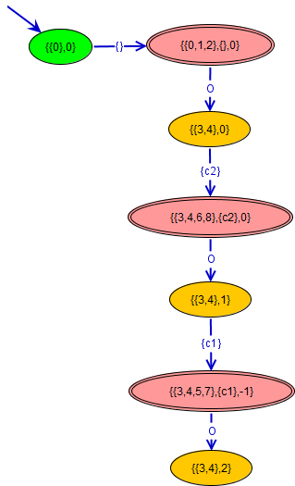
Output File: UBTS.fsm
.fsm file of final iteration of Unfolded Bipartite Transition System
Desuma format
E.g.
7
{{0},0} 0 1
{} {{0,1,2},{},0} c o
...

Slide 9
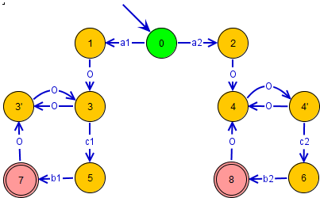
Output File: A_UxG_reduced.fsm
.fsm file of closed loop behavior
Desuma format
E.g.
11
0 0 2
a2 2 uc uo
a1 1 uc uo
...

Slide 10
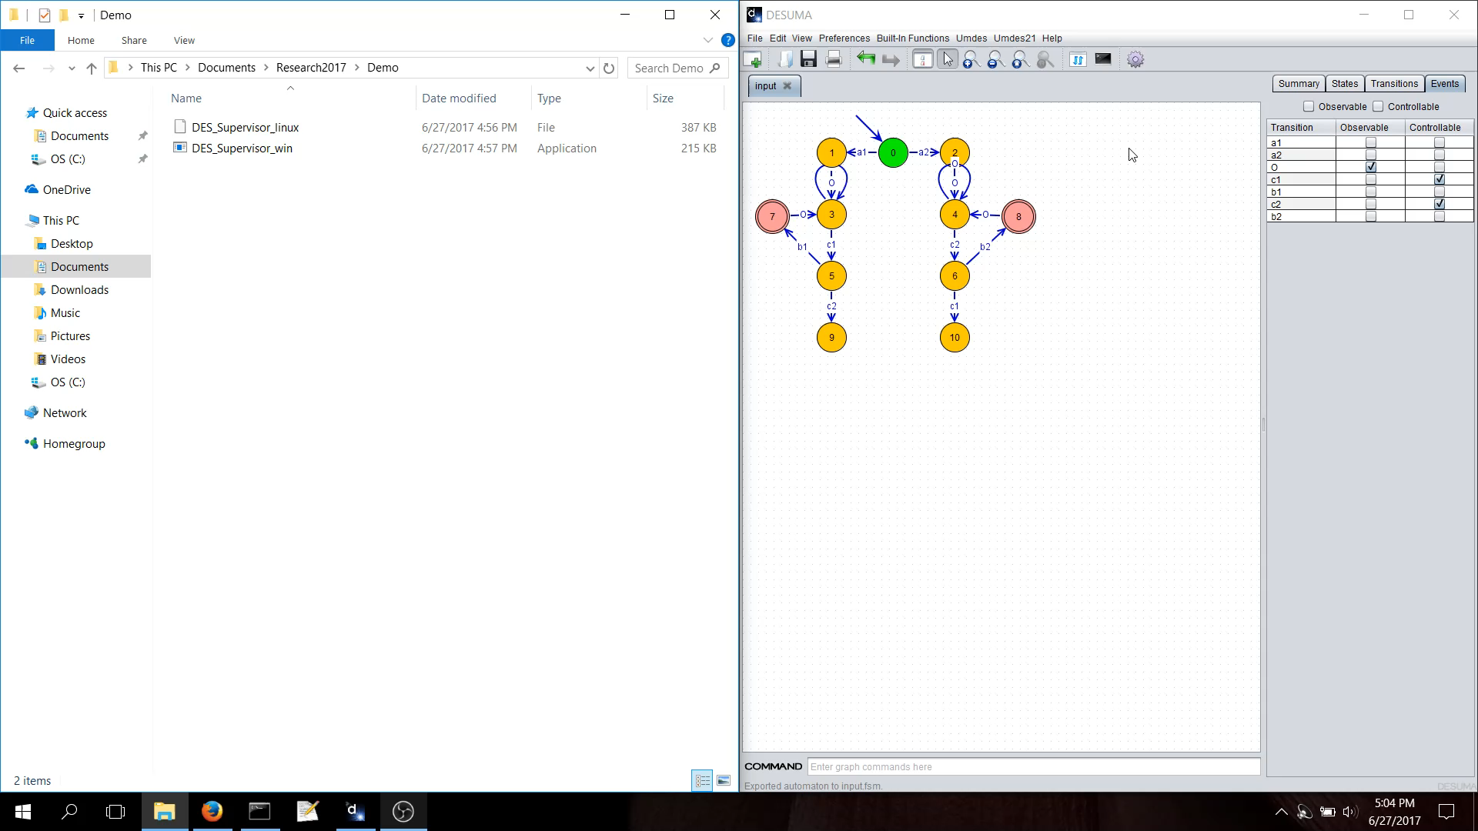
Video Demonstration

